Slide 1
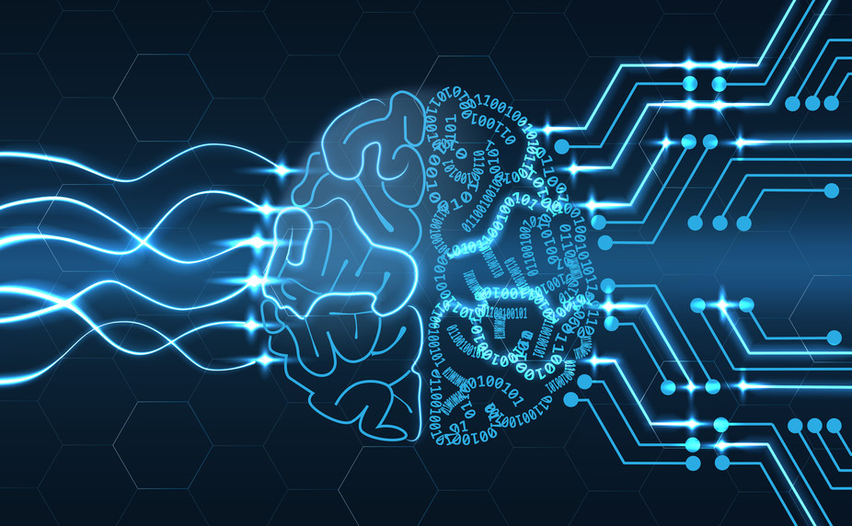
Artificial intelligence
Trabelsi Oussema | Rabonarijaona Solofo

Slide 2
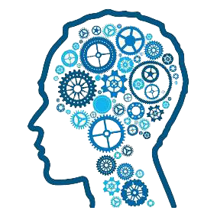
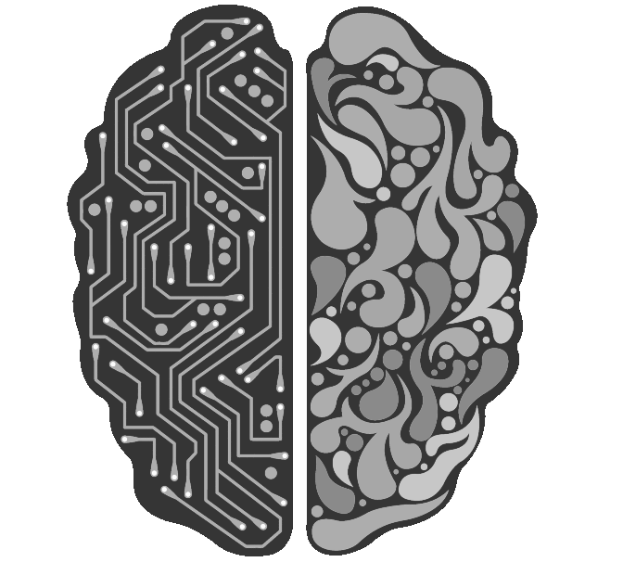
SOMMAIRE:
Introduction
History
The Principle of Ai
Goals
Application
Conclusion and Future of Ai

Slide 3
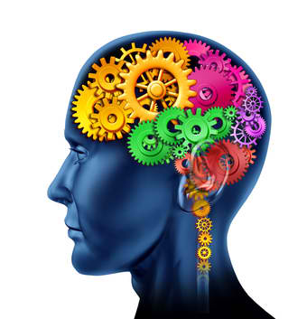
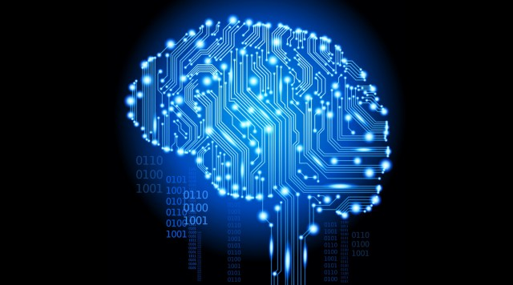
Intelligence ?
What is Artificial Intelligence ??

Slide 4
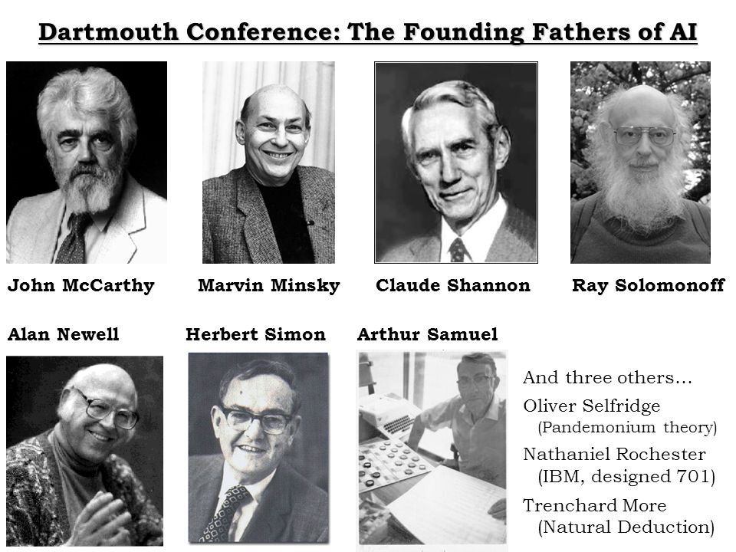
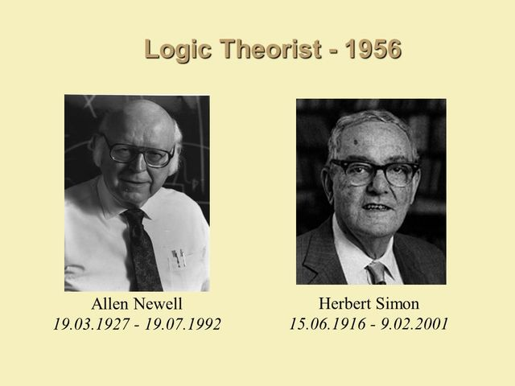
HISTORY:
1956
Dartmouth Conference

Slide 5
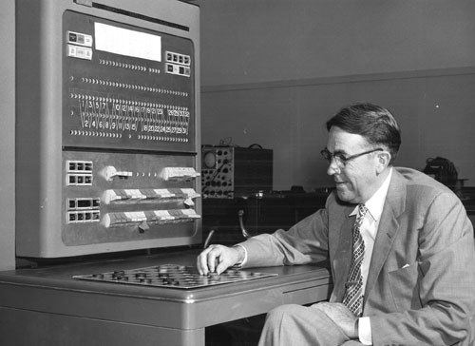
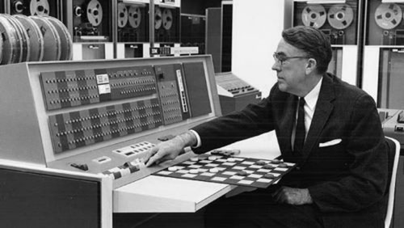
HISTORY:
1956
1952-62
First game-playing program:

Slide 6
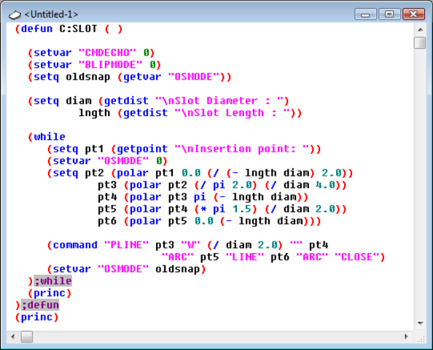

HISTORY:
1956
1952-62
1958
Lisp language:

Slide 7

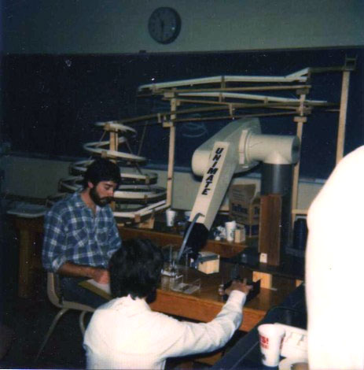
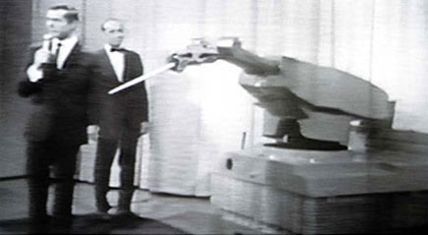
HISTORY:
1956
1952-62
1958
1962
Unimation Founded:

Slide 8


HISTORY:
1956
1952-62
1958
1962
1963
DARPA Advanced Research Projects:
Defense Advanced
Research Projects Agency

Slide 9
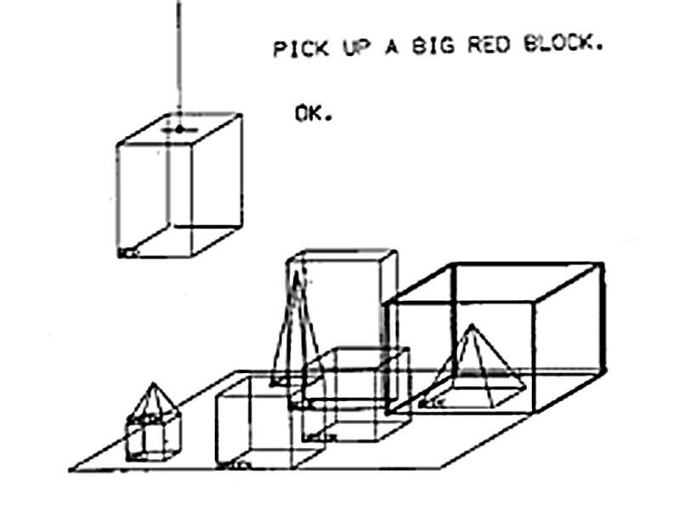
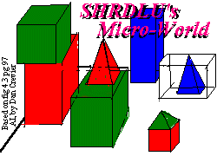
HISTORY:
1956
1952-62
1958
1962
1963
1968
Microworld Program, SHRDLU Created :

Slide 10
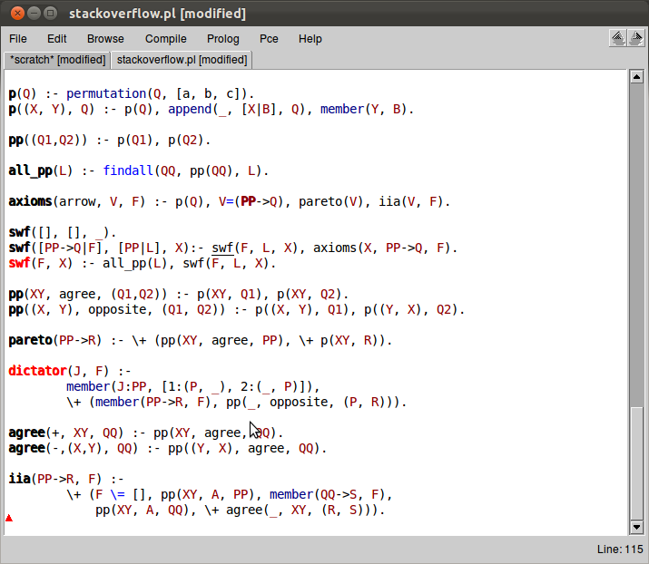


HISTORY:
1956
1952-62
1958
1962
1963
1968
1972
PROLOG Language Revealed :

Slide 11
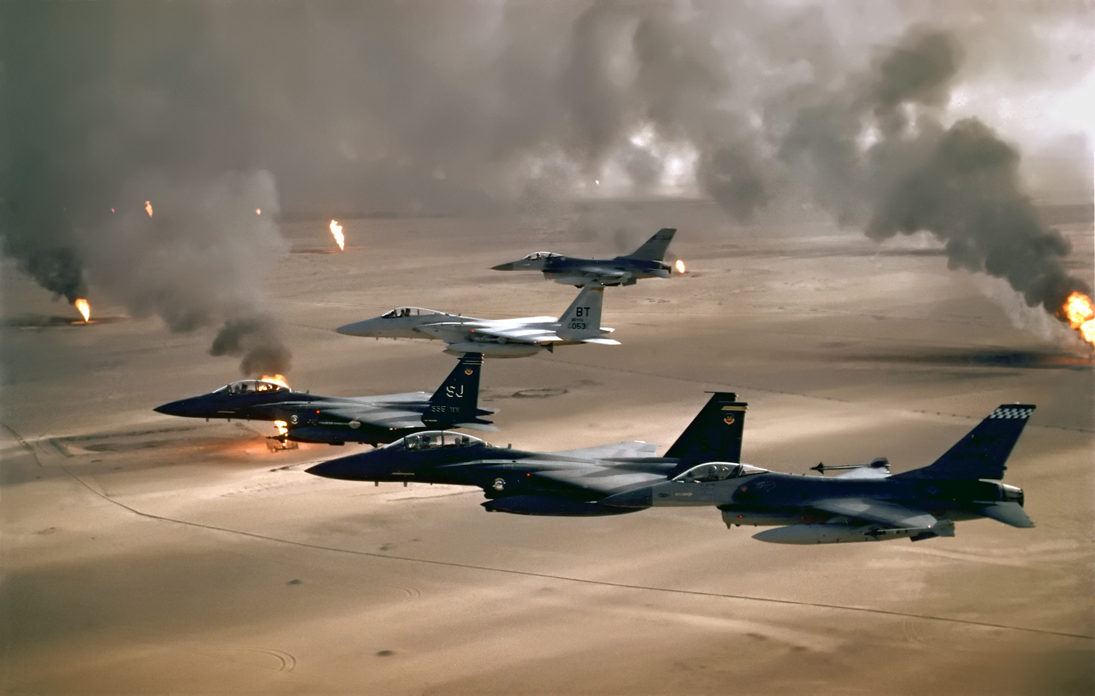
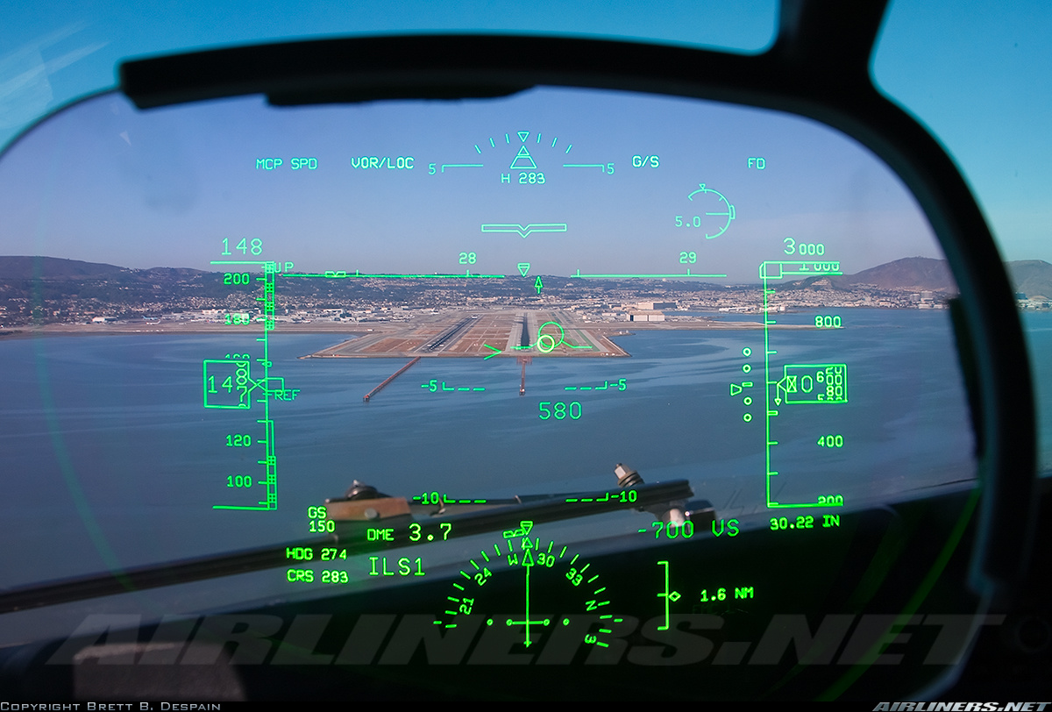
HISTORY:
1956
1952-62
1958
1962
1963
1968
1972
1991
AI Military Systems used in Desert Storm:

Slide 12
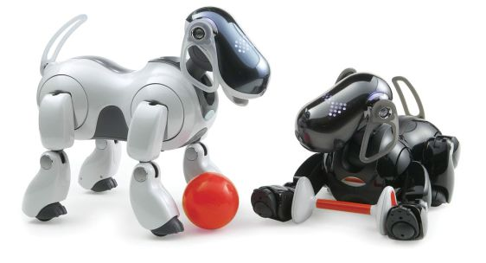
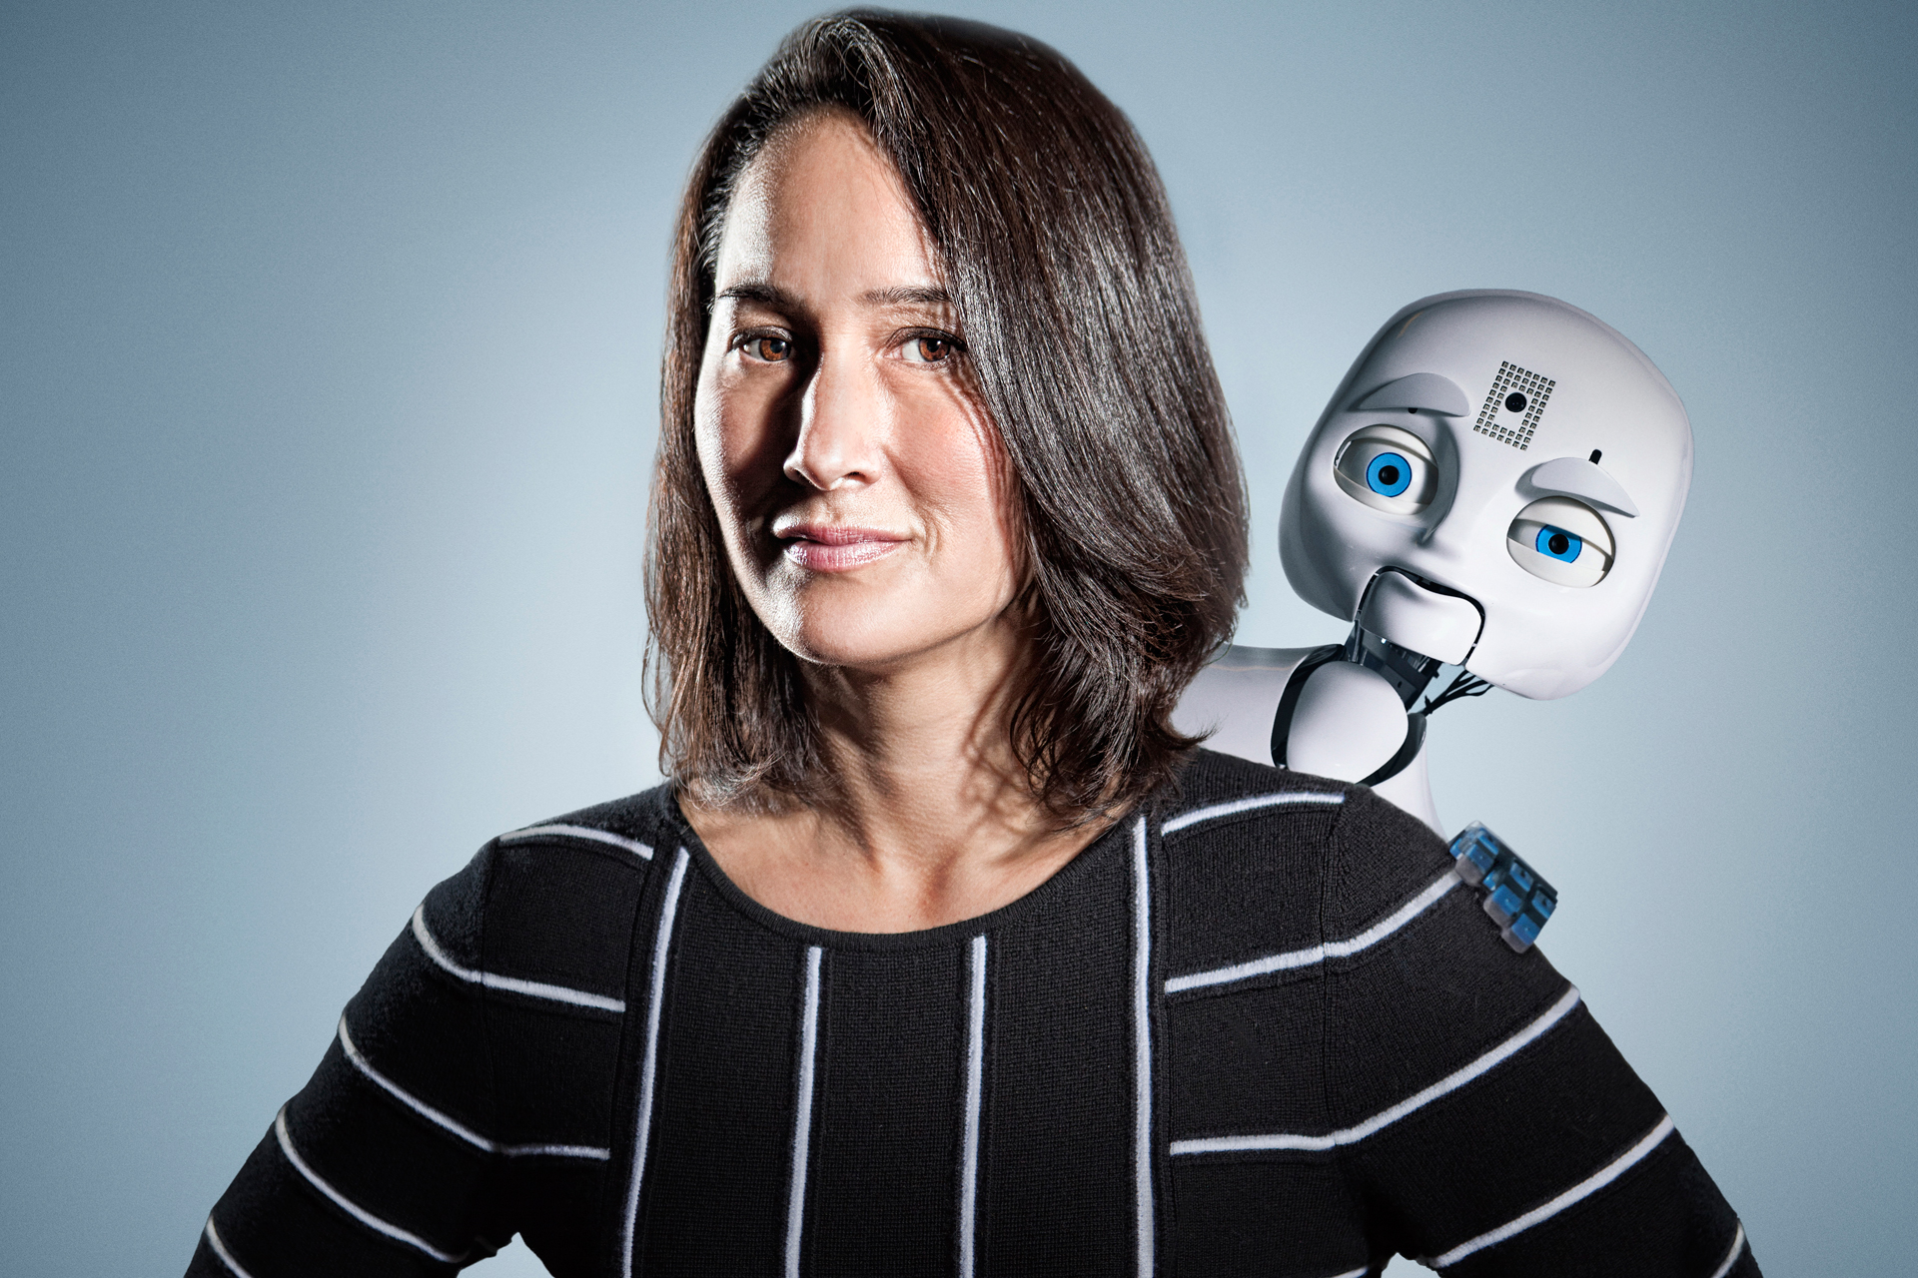
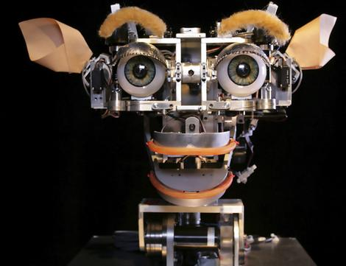
HISTORY:
1956
1952-62
1958
1962
1963
1968
1972
1991
2000’s
robot pets and KISMET robot:

Slide 13
The Principle of Ai
Solo a toi de faire cette partie bro tu met un exemple
Fait comme moi faut juste mettre des photo et quelques phrases
Interdit de mettre des paragraphes ☺ ☺

Slide 14
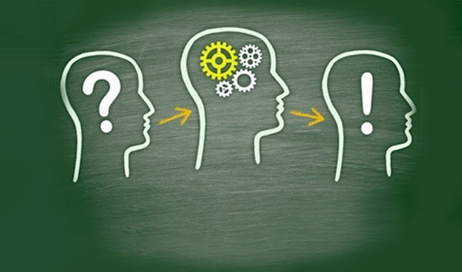
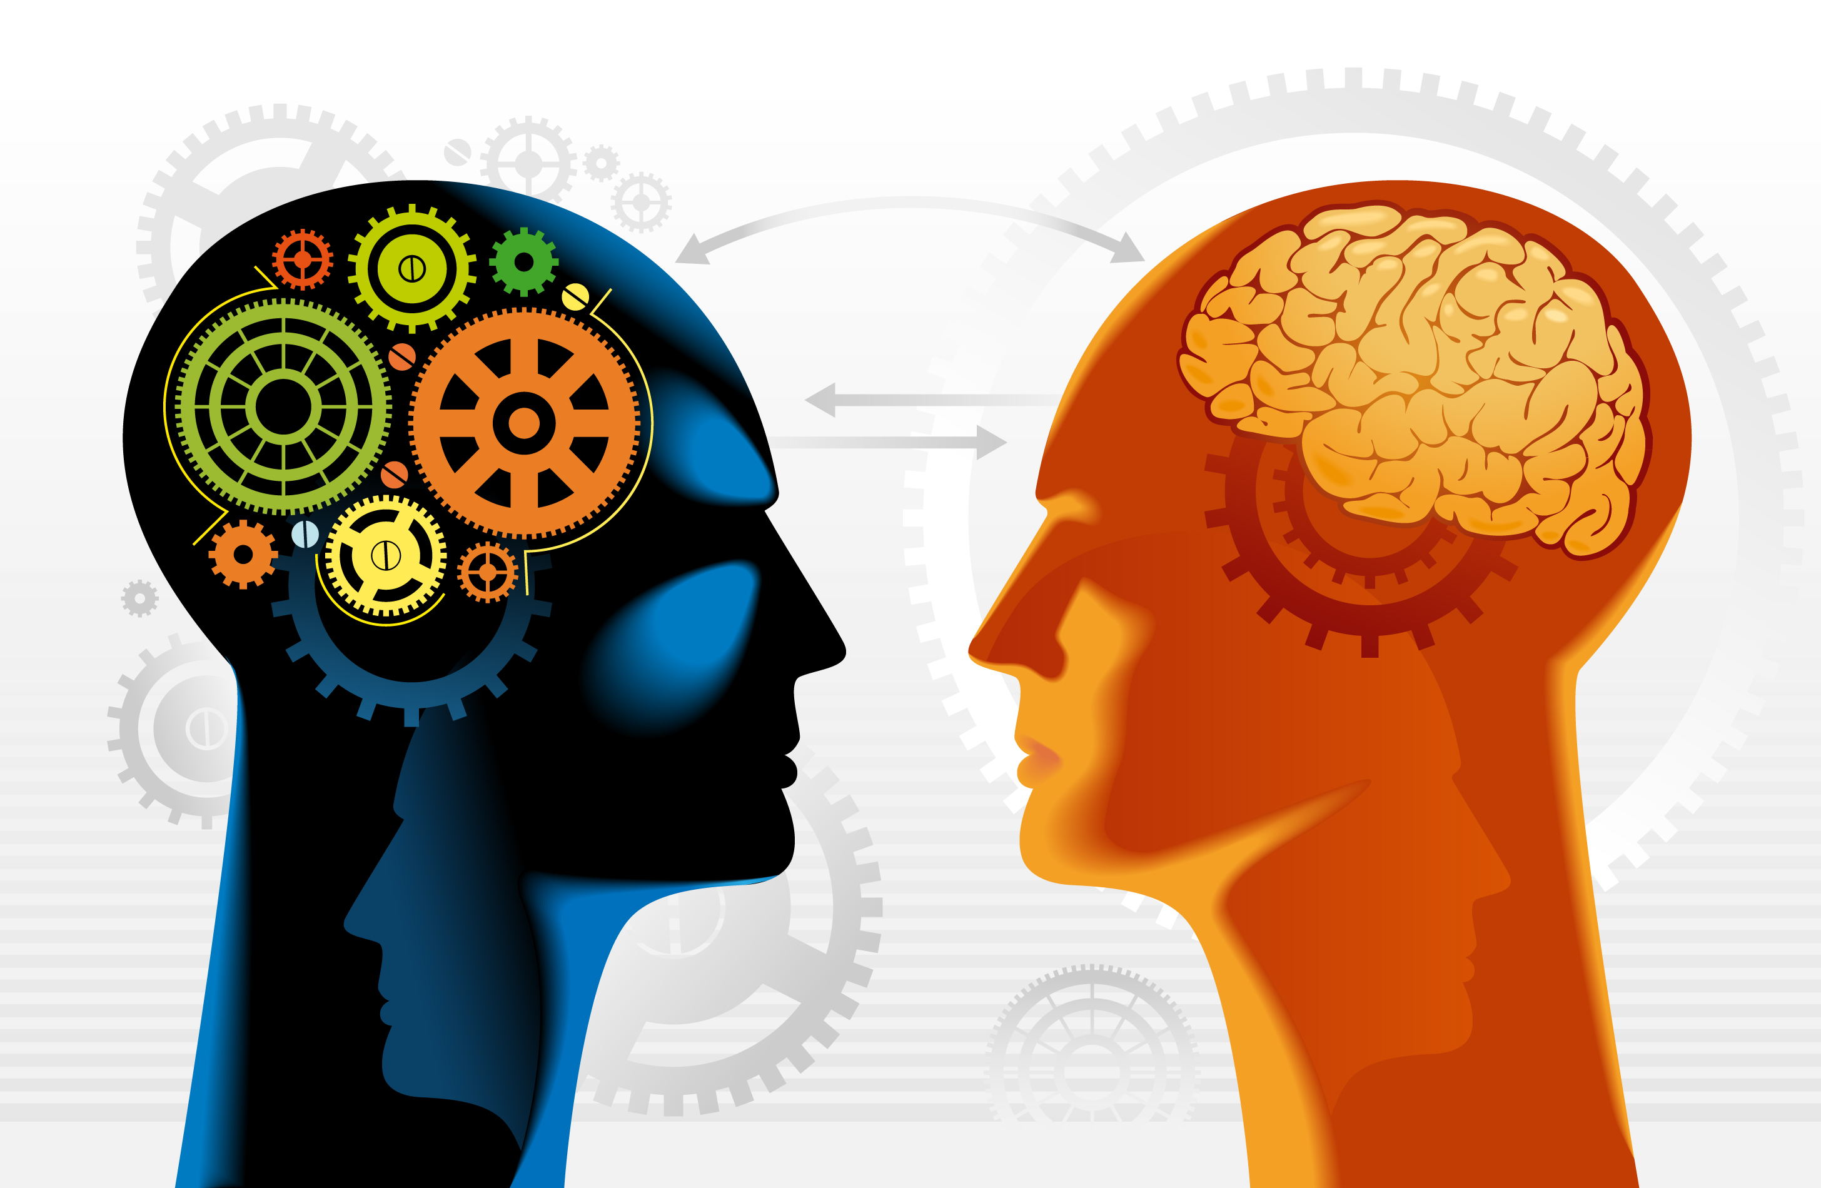

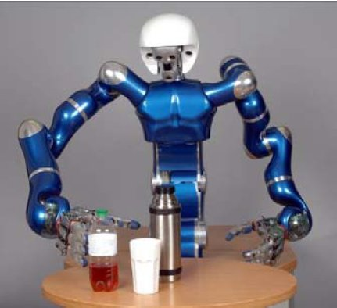
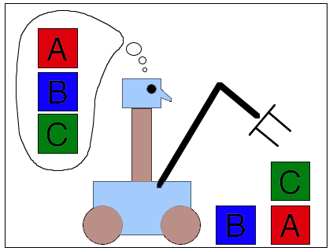
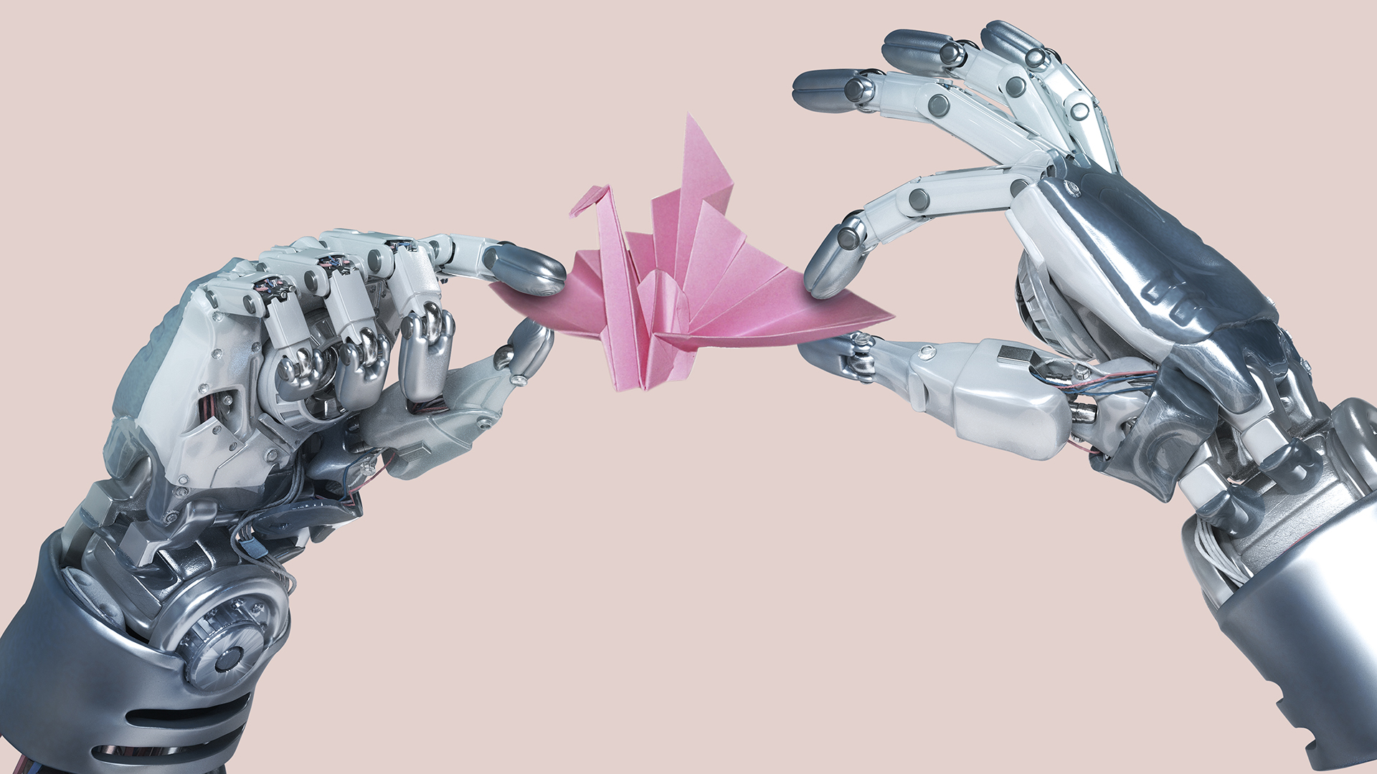
Goals:
Deduction , Reasoning ,problem sloving
Knowledge Representation
Planning
Natural language processing
Manipulation
Creativity

Slide 15


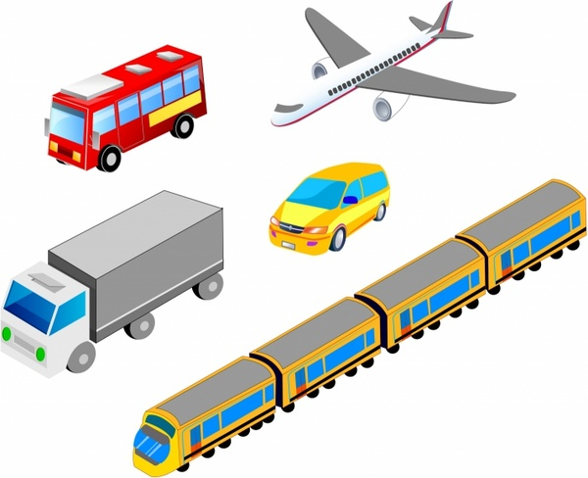
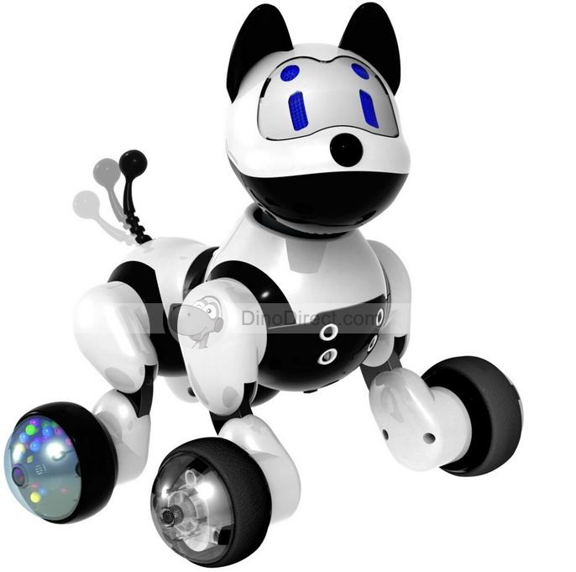
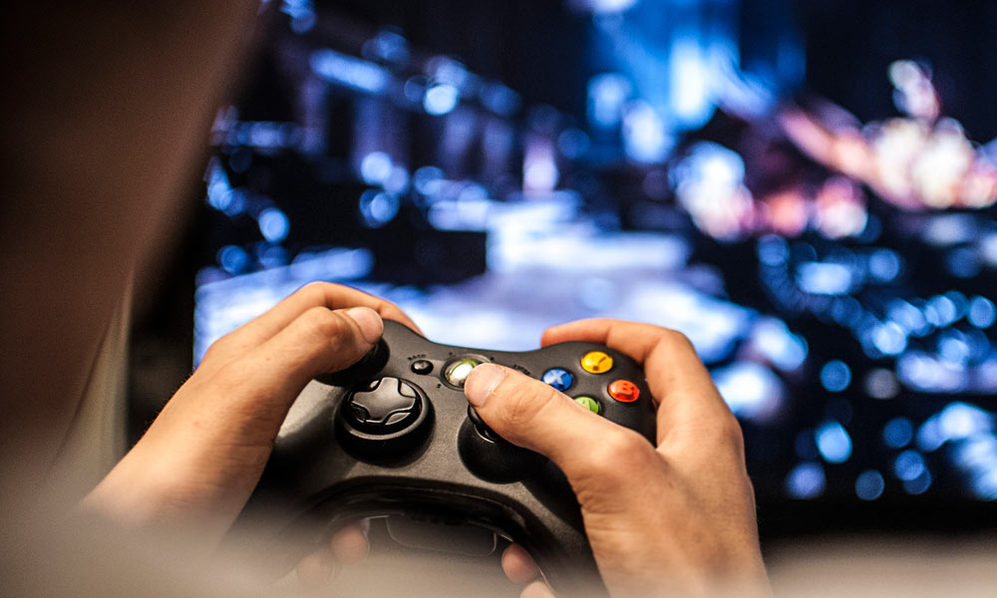
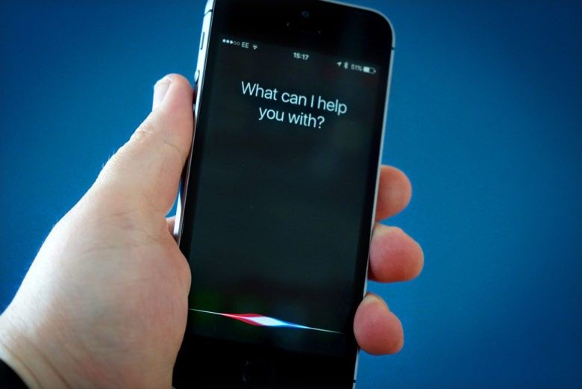
Application:
Music
Transportation
Hospitals
Medical Diagnosis
Toys and Games
Video Games
Expert systems
Question answering
Finance

Slide 16
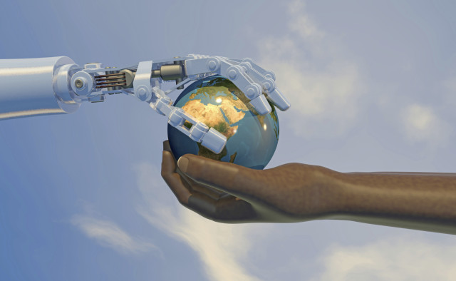
CONCLUSION

Slide 17


